Slide 1


Slide 2
TEAM >> DIGI.PHOENIX
TEAM LEADER >> Ravindra Singh Rajawat

Slide 3
Team Members & Their Roles
Ravindra Singh {DataBase Handler & Tester}
Abhishek Saini {Front-End Developer}
Piyush Agarwal {Layout Designer}
Anushka Sharma {Feasible Tester}
Poonam Kanwar {Requirements Analyst}
Sarvesh Kumar {Android Developer}

Slide 4
Problem Given By :- SIH 2020
According to govt there is no monitoring system to monitor the progress of construction of houses under Rural Housing schemes. To generate real time statistical report of the ongoing constructions. Design web based dashboard for monitoring and a native mobile application to track the progress of the construction just by taking a photograph by using the application itself.

Slide 5
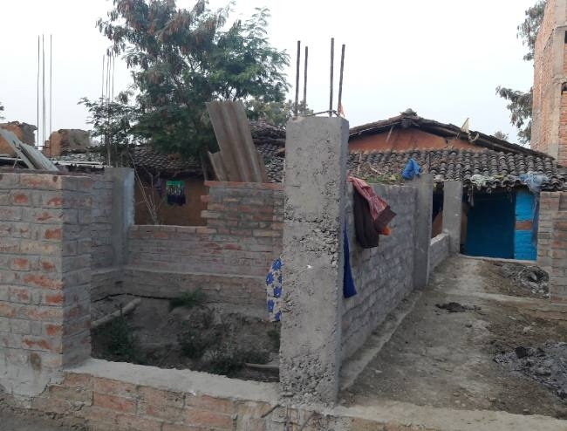
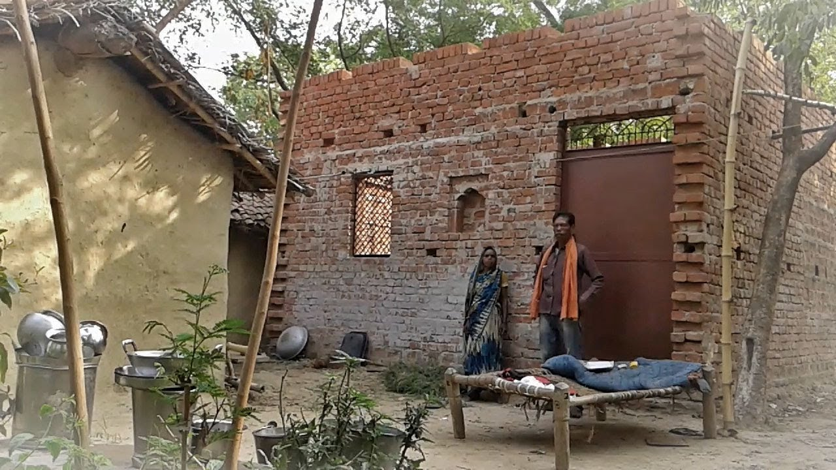
Problem Faced by people :-

Slide 6
Flaws in past project :-
1.IAY-
• The scheme was starts in 1980
• Indira Awas Yojana was a housing scheme for the poor during the UPA regime. It is now rechristened as Prime Minister Awas Yojana under NDA regime.
• Loop holes-not completed house till 2015.
2. Ntr rural housing (loopholes)
1. fake billing
2. corruption
3. low quality material

Slide 7
TECHNOLOGY STACK
• Bootstrap(HTML,CSS).
• PHP
• Java Script
• Android(Java).
• Database( MySQL).
• Servers(Web Hosting ).
• Related Libraries as required.

Slide 8
Our Solution
<<<<<<<>>>>>>>

Slide 9
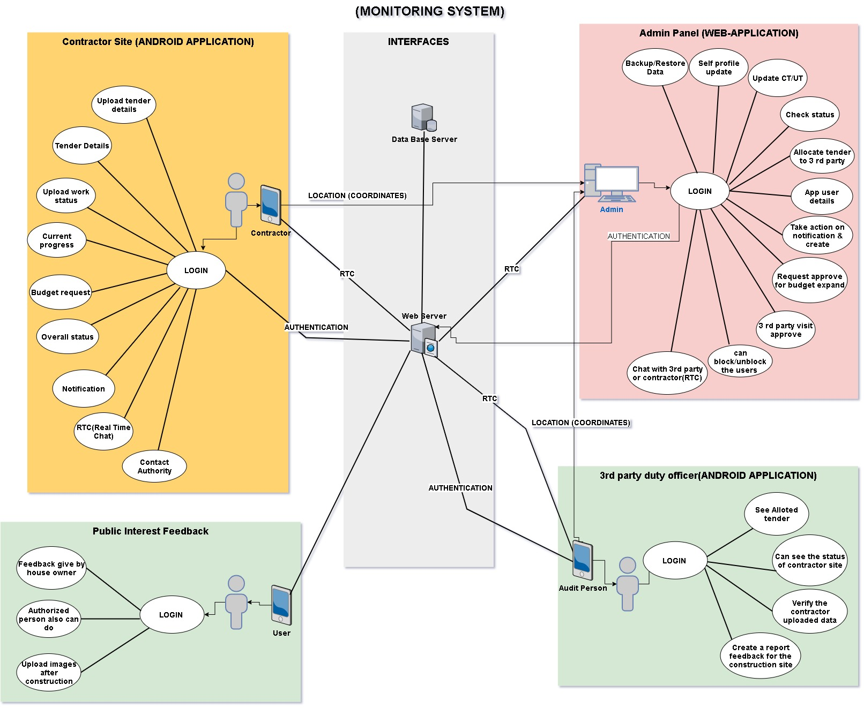

Slide 10
Construction Site

Slide 11
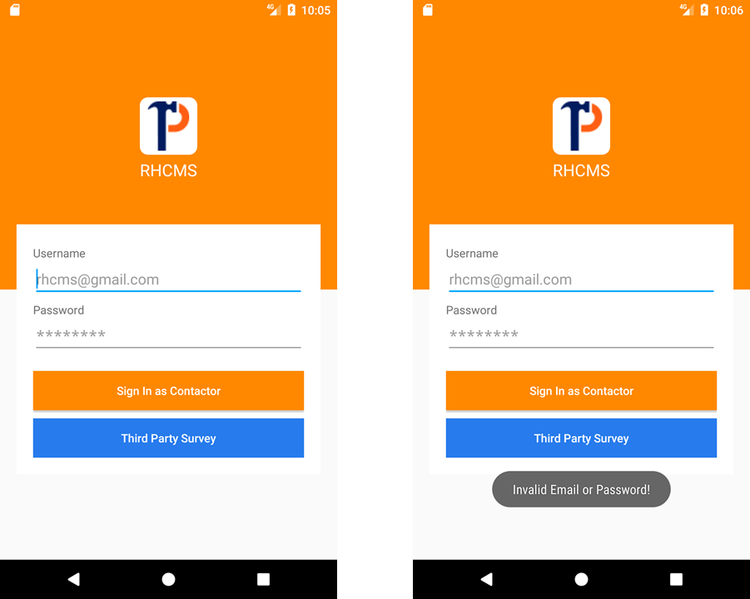

Slide 12
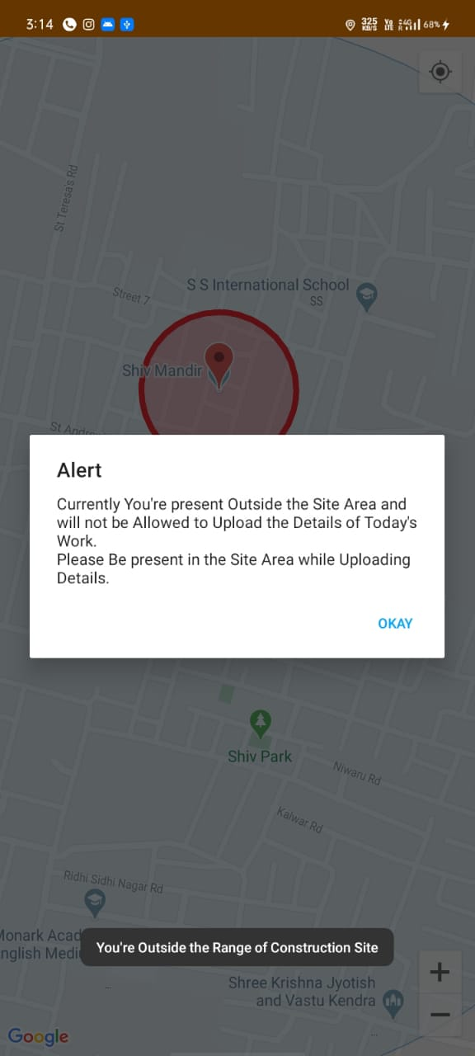
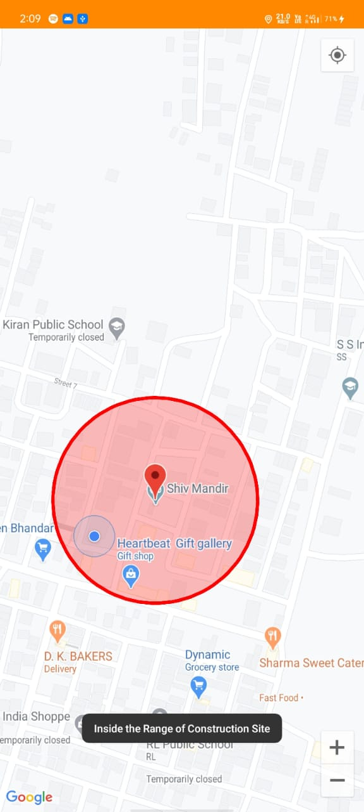

Slide 13
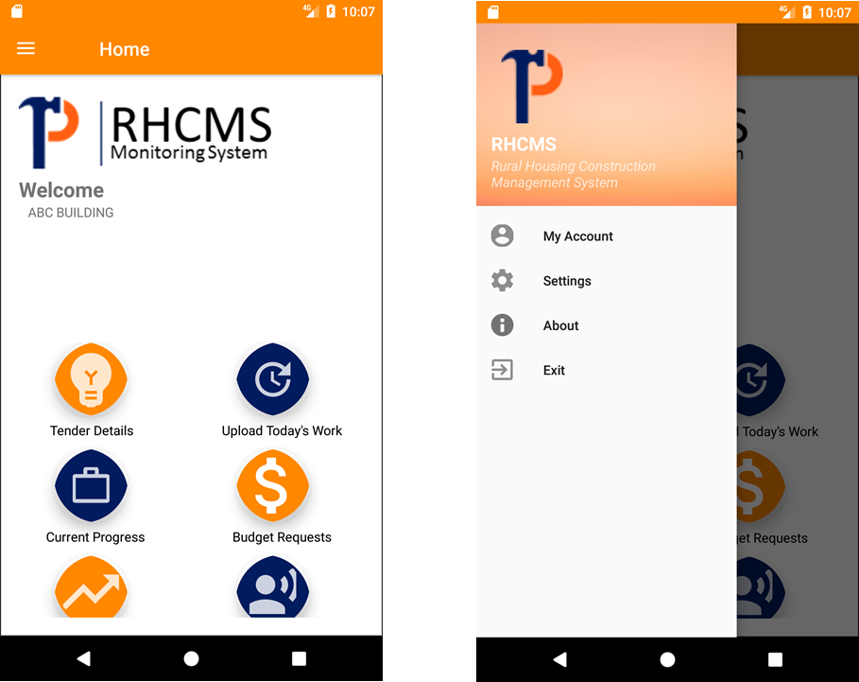

Slide 14
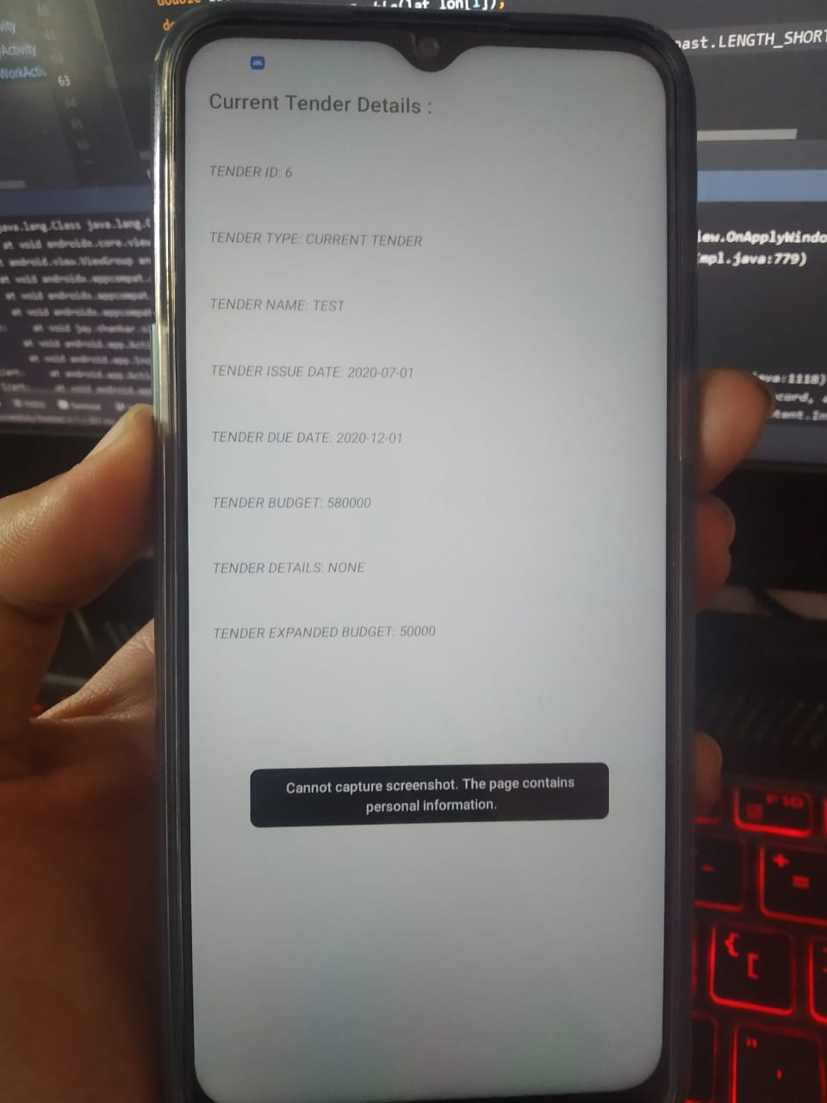
Screenshot is not allowed and no copy paste

Slide 15
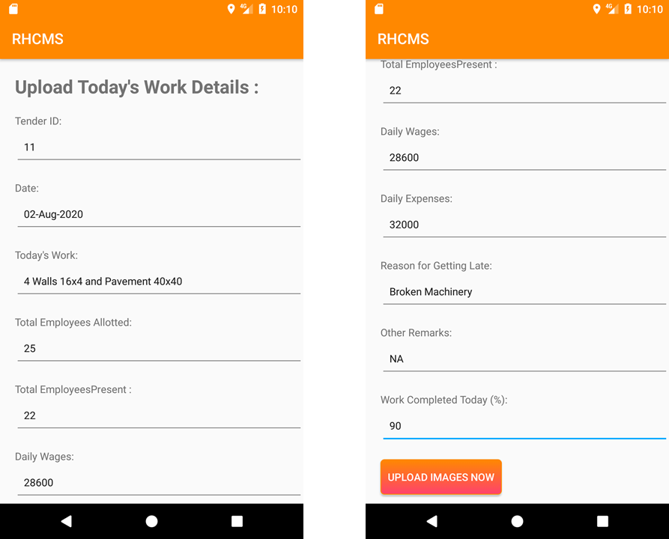

Slide 16
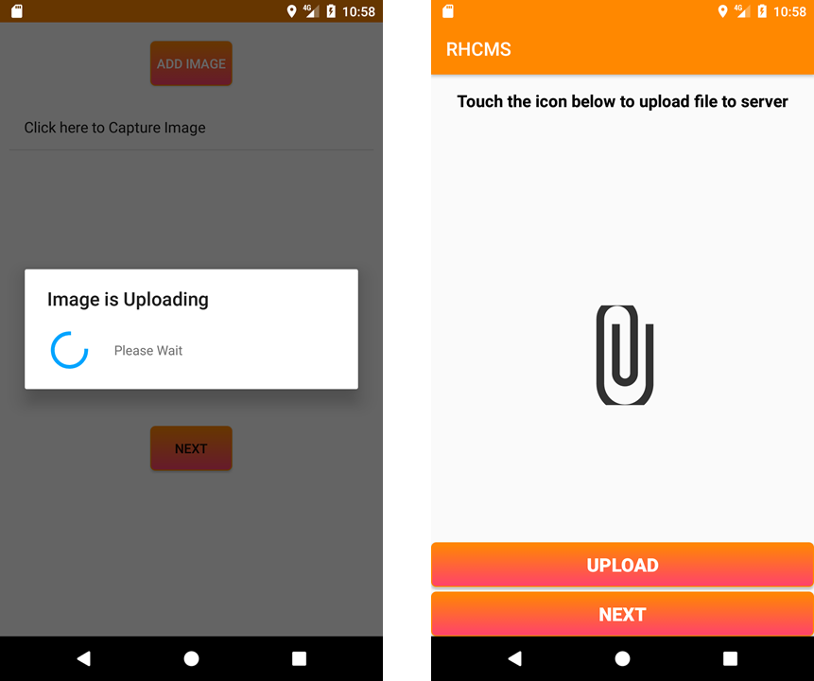

Slide 17
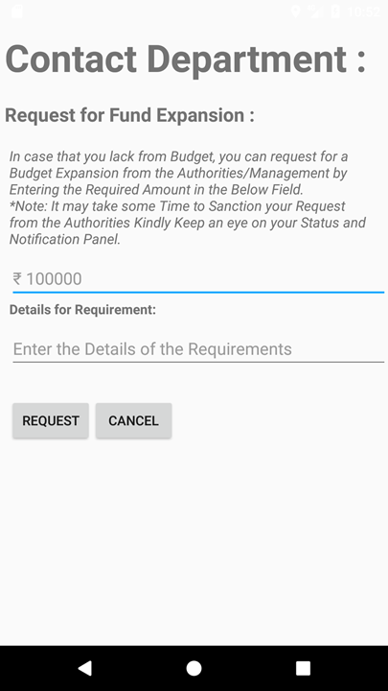
For fund request

Slide 18
ANDROID Security Aspects :-
Strong validation on every text field
No copy paste is allowed from outside resources
No capturing of screen is allowed
Accessing coarse location instead of google map
Application is allowed to be operated only on the construction site

Slide 19
Government Site

Slide 20
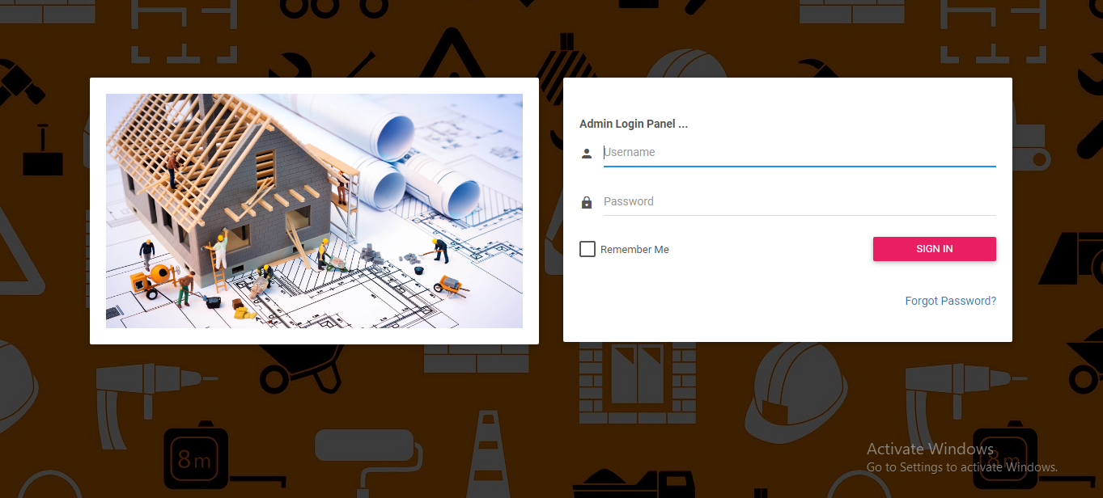


Slide 21
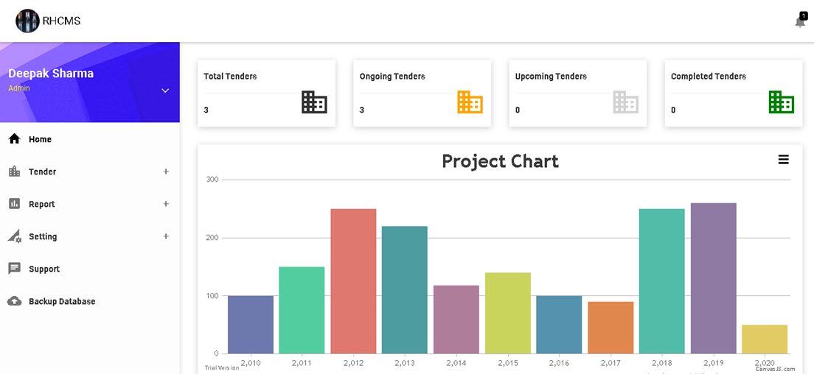

Slide 22
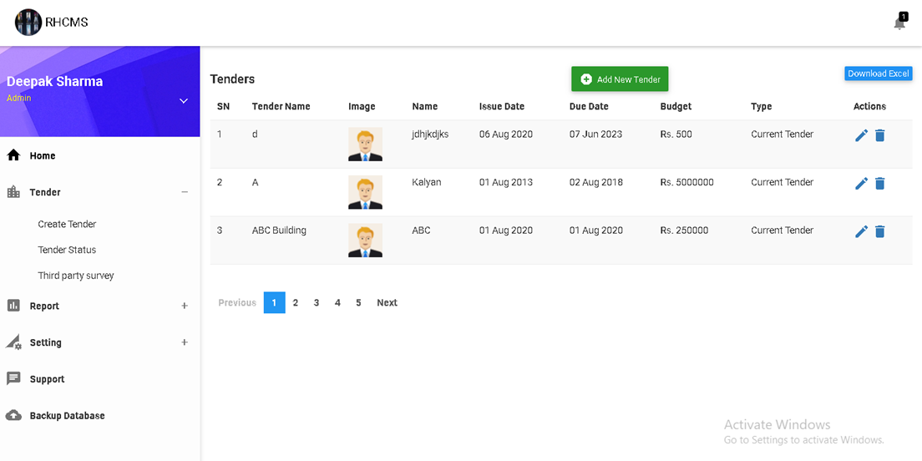

Slide 23
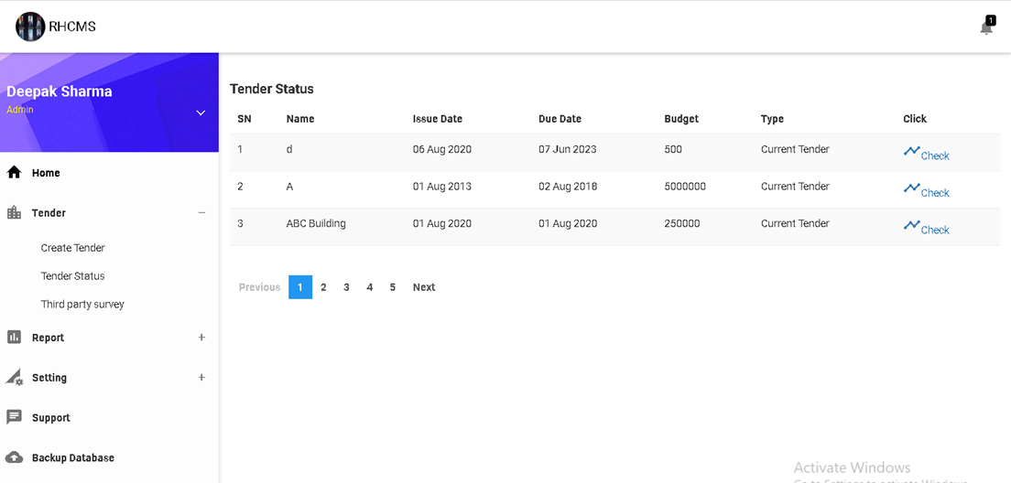
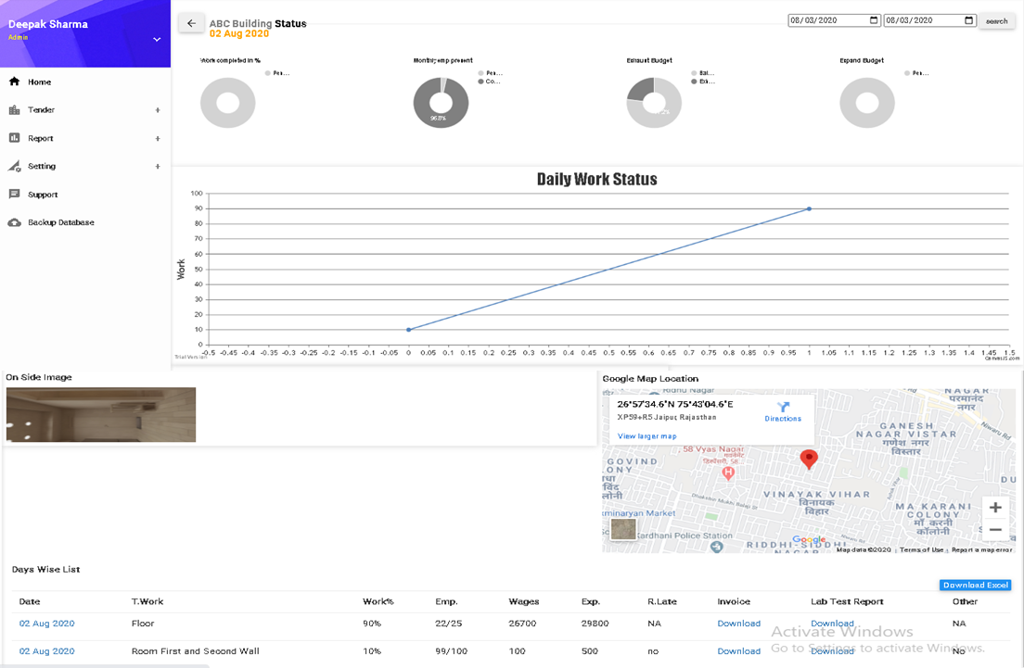

Slide 24
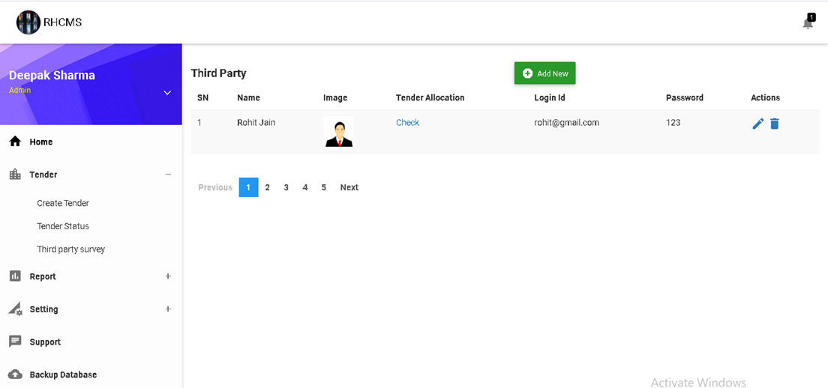

Slide 25
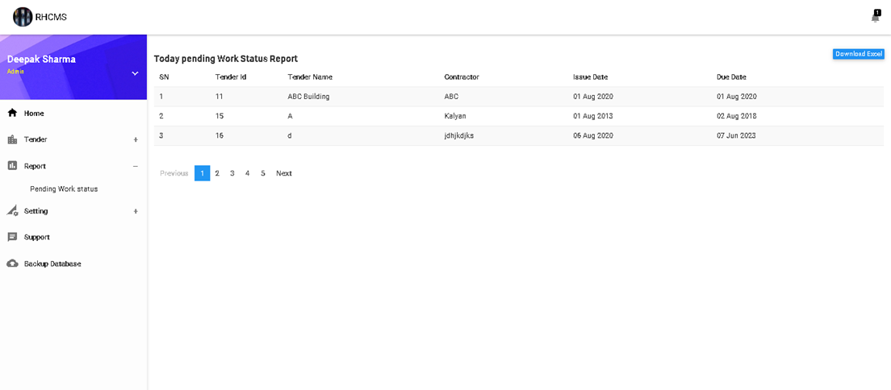

Slide 26
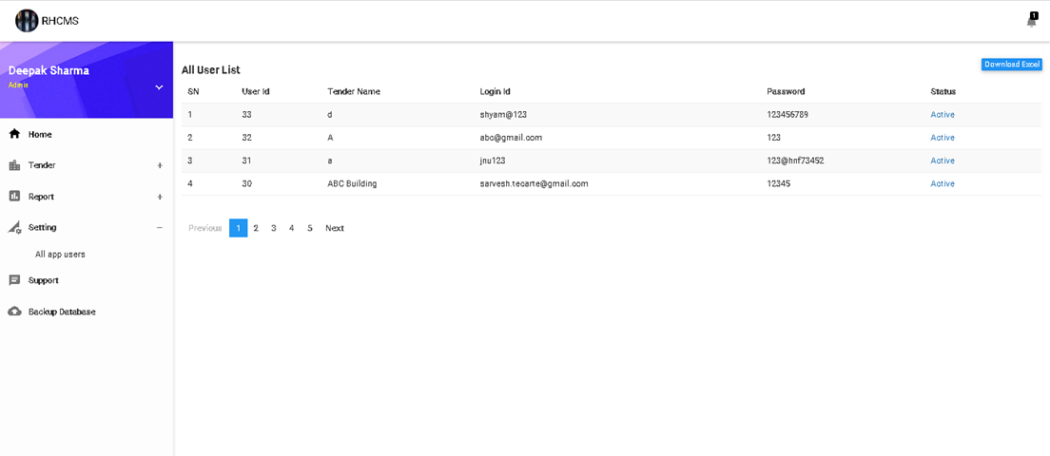

Slide 27
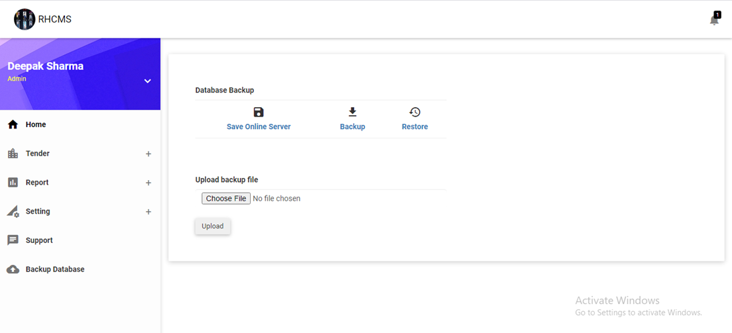

Slide 28
3rd party On-site

Slide 29
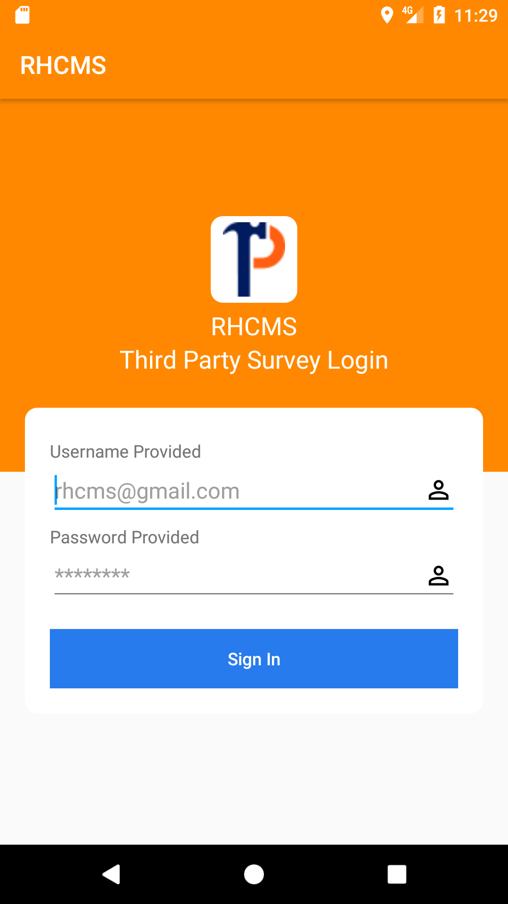

Slide 30
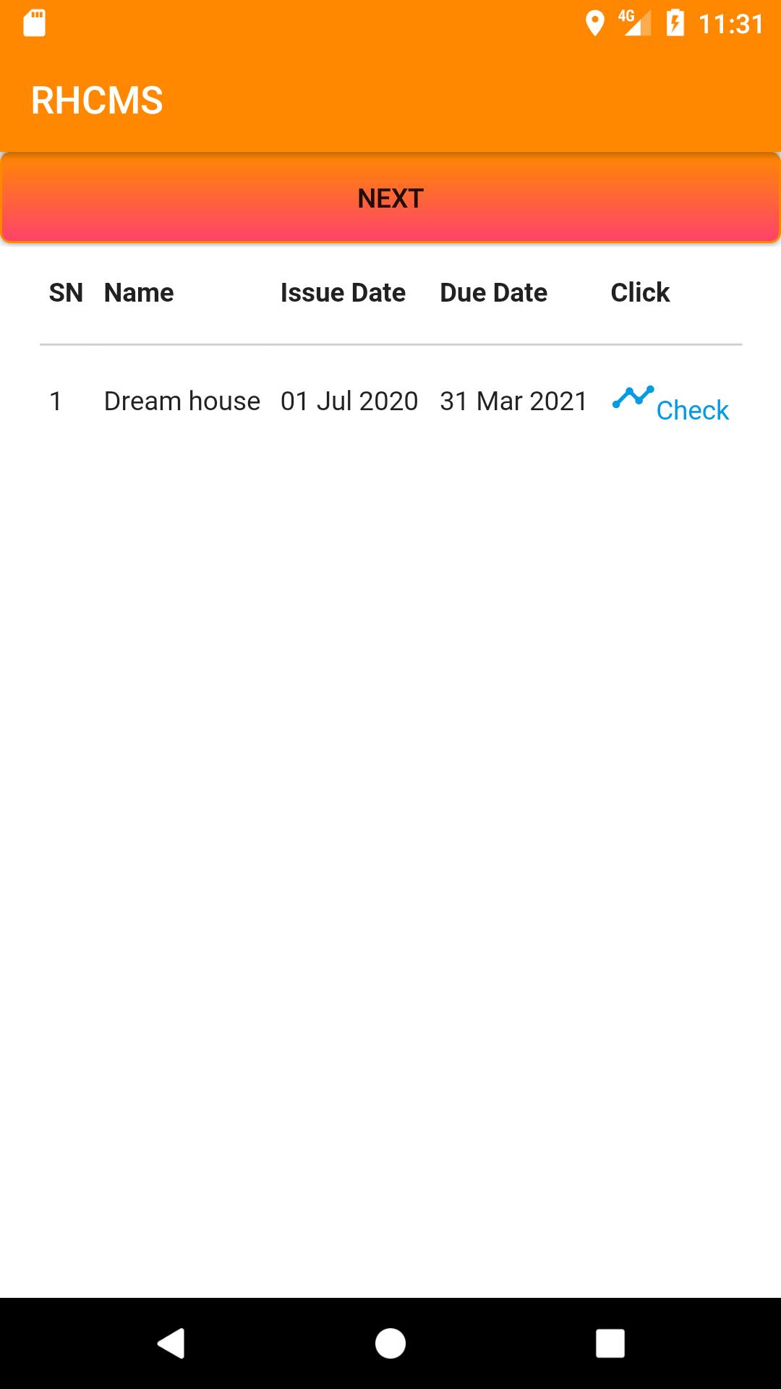

Slide 31
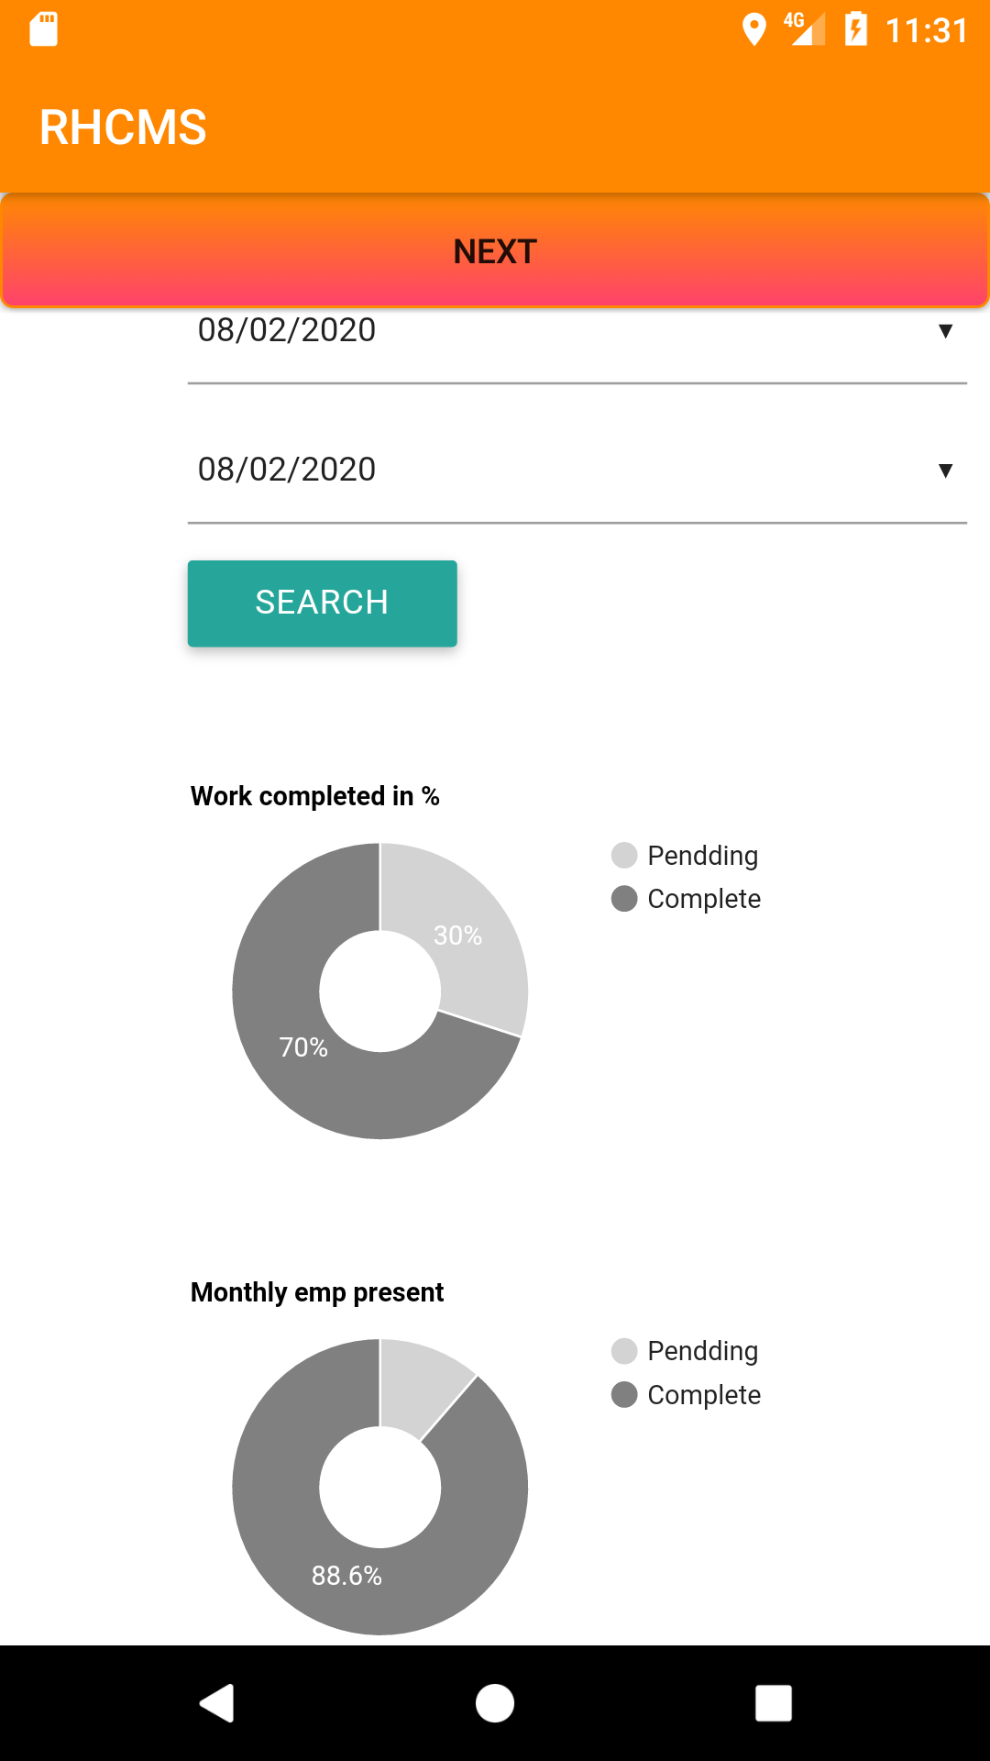

Slide 32
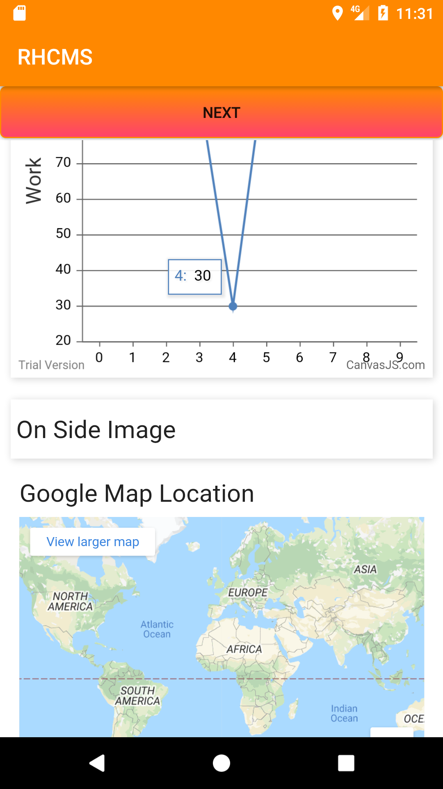

Slide 33
Code for text field validation

Slide 34
email = (EditText) findViewById(R.id.email);
if (Build.VERSION.SDK_INT >= Build.VERSION_CODES.P) {
email.setCustomInsertionActionModeCallback(new ActionMode.Callback() {
@Override
public boolean onCreateActionMode(ActionMode mode, Menu menu) {
return false;
}
@Override
public boolean onPrepareActionMode(ActionMode mode, Menu menu) {
return false;
}
@Override
public boolean onActionItemClicked(ActionMode mode, MenuItem item) {
return false;
}
@Override

Slide 35
public void onDestroyActionMode(ActionMode mode) {
}
});
}
email.setCustomSelectionActionModeCallback(new ActionMode.Callback() {
@Override
public boolean onCreateActionMode(ActionMode mode, Menu menu) {
return false;
}
@Override
public boolean onPrepareActionMode(ActionMode mode, Menu menu) {
return false;
}
@Override
public boolean onActionItemClicked(ActionMode mode, MenuItem item) {
return false;
}
@Override
public void onDestroyActionMode(ActionMode mode) {
}
});
email.setLongClickable(false);
email.setTextIsSelectable(false);

Slide 36
This code prevents from screen-capturing
getWindow().setFlags(WindowManager.LayoutParams.FLAG_SECURE, WindowManager.LayoutParams.FLAG_SECURE);

Slide 37
Code for finding range of coordinates
float[] dist = new float[5];
Location.distanceBetween(lat,lon,current_lat,current_lon,dist);
if(dist[0]/1000 > 1){
Toast.makeText(UpdateTodaysWorkActivity.this,"Outside Range",Toast.LENGTH_SHORT).show();
} else
Toast.makeText(UpdateTodaysWorkActivity.this,"Inside Range",Toast.LENGTH_SHORT).show();

Slide 38
ANDROID Security Aspects :-
Strong validation on every text field
No copy paste is allowed from outside resources
No capturing of screen is allowed
Accessing coarse location instead of google map

Slide 39
Public Website Page

Slide 40
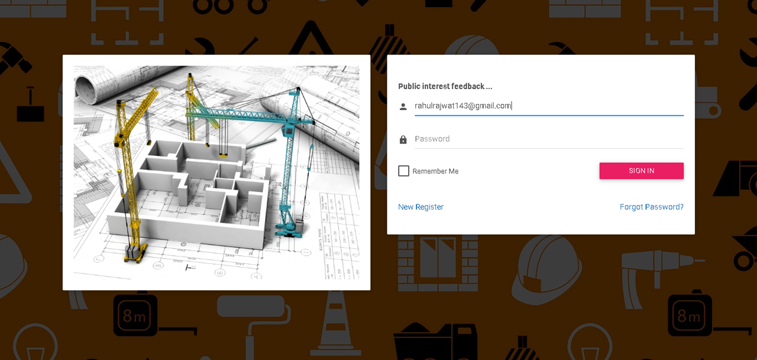
Public Login Page

Slide 41
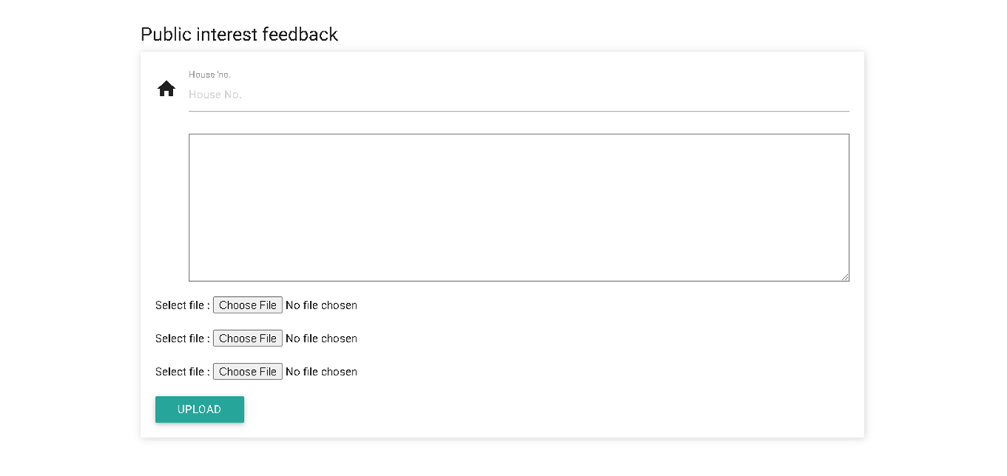
Public Interest Feedback
http://gyanamonline.com/rhcms/

Slide 42
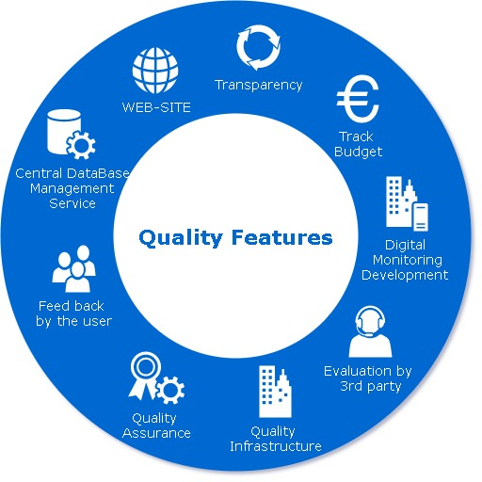

Slide 43
DEPENDENCIES
1.ONE WEB HOST SERVER
2.SMART PHONE FOR ANDROID (APK)
3.CURRENT GLOBAL POSITIONING SYSTEM
4.INTERNET CONNECTION
5.INFORMATION FROM GOVT. MANAGEMENT AND CONTRACTORS
6.SITE VALIDATION BY THIRD PARTY

Slide 44
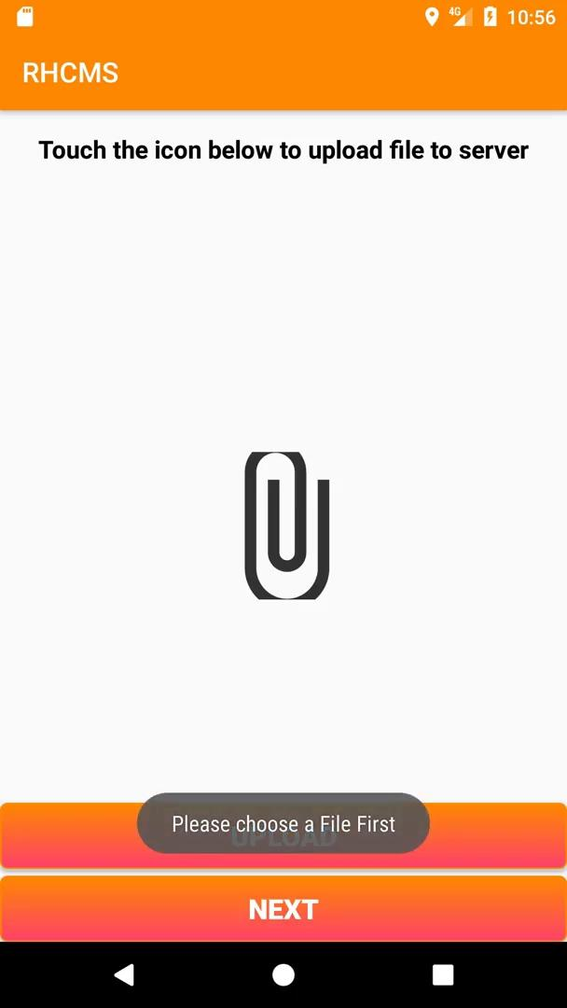
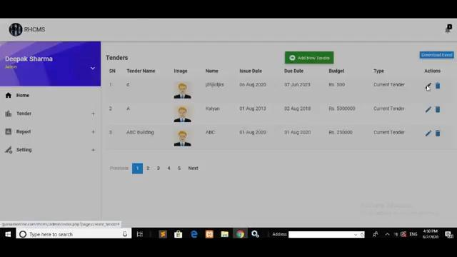
For Demo Please Follow This Below Link
http://gyanamonline.com/rhcms/

Slide 45
